Slide 1
Feasibility of Multi-Cut-Off Rebar
for Construction Application
Advisor : Prof. K.C.Chang
Presenters : You-Ran Nai
Notes:
Try 講清楚脈絡

Slide 2
Outline
Part 2
Part 4
Flexural Reinforcement Multi-Cut
Seismic Verification
Part 1
Part 3
Objective
Condition

Slide 3
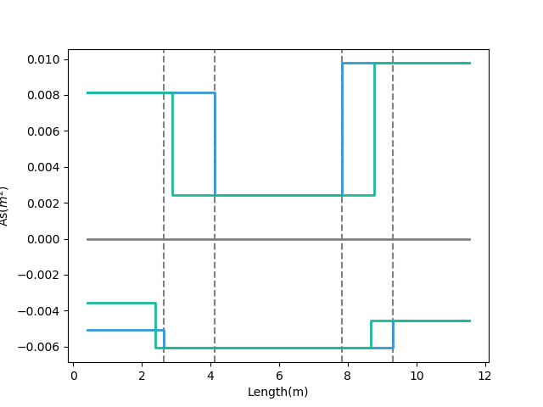
- Tradition
- Multi-Cut-2
梁用鋼量圖
12-#10
10-#10
REDUCE REBAR
Top Rebar
3-#10
7-#8
9-#8
Bottom Rebar
Real
Demand
12-#8
Notes:
LowSeismic4Floor12M 0

Slide 4
- Tradition
- Multi-Cut-2
梁用鋼量圖
12-#10
10-#10
REDUCE REBAR
Top Rebar
3-#10
7-#8
9-#8
Bottom Rebar
Real
Demand
12-#8
Notes:
LowSeismic4Floor12M 0

Slide 5
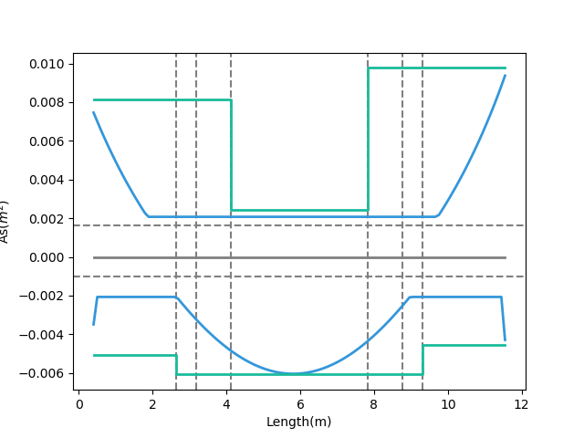
- Design As
12-#10
10-#10
- Demand As
Today’s Solution
Fixed Bar-Cut
3-#10
Top Rebar
10-#8
9-#8
12-#8
Bottom Rebar
Notes:
LowSeismic4Floor12M 0

Slide 6
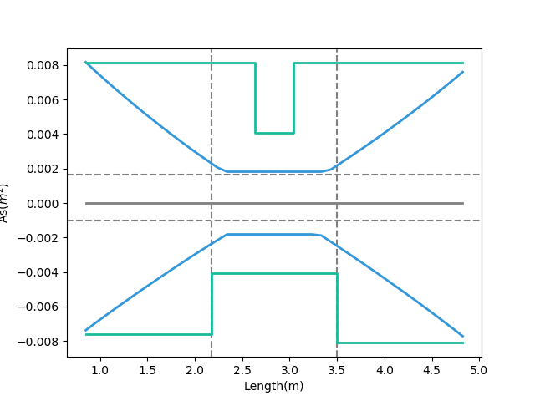
Tradition
- Design As
- Demand As
Top Rebar
Bottom Rebar
Notes:
欣銓 1140

Slide 7
Outline
Part 2
Part 4
Flexural Reinforcement Multi-Cut
Seismic Verification
Part 1
Part 3
Objective
Condition

Slide 8
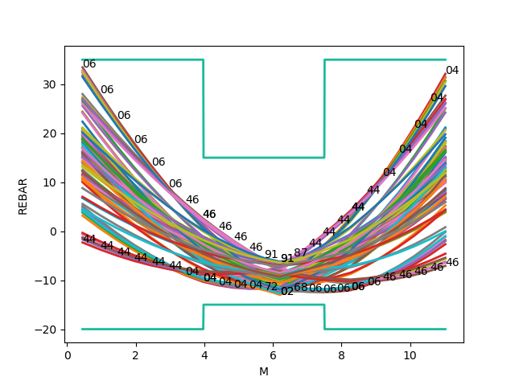
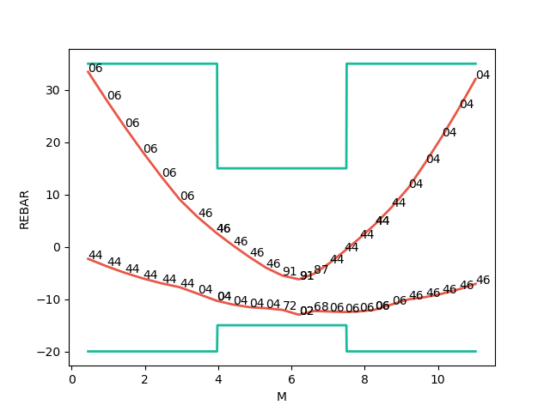
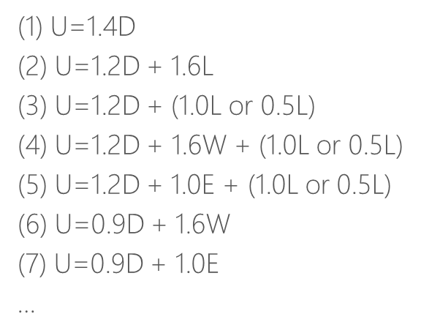


Mu
Consider Hundreds Of Combo Demand
Catch Critical Demand Combo
$$A_{s}({cm}^{2})$$
$$A_{s}({cm}^{2})$$
Length(m)
Length(m)

Slide 9
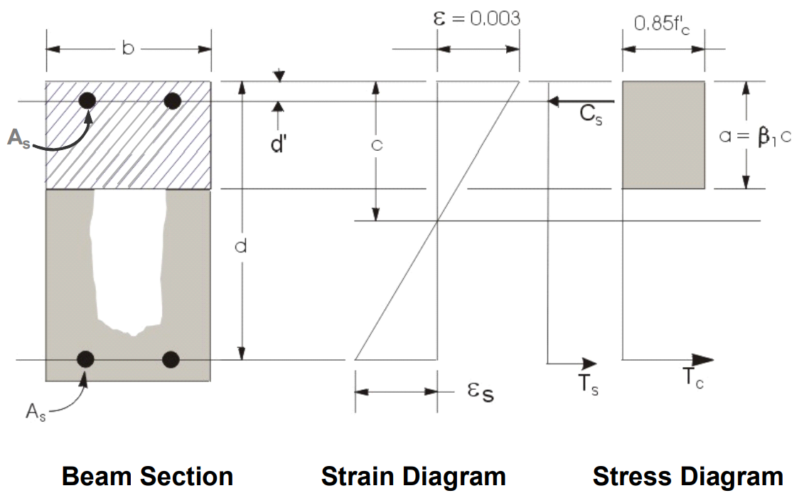
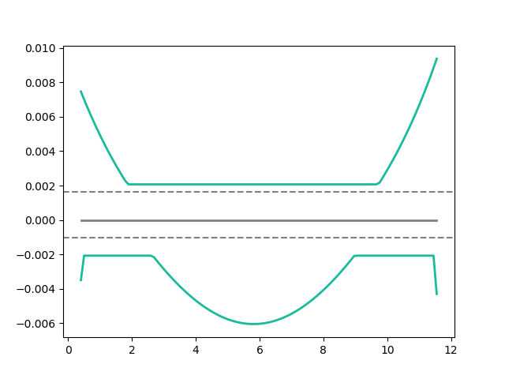
Flexural Reinforcement
- Demand As
Min: 2 Rebar
Notes:
LowSeismic 4Floor 12M 0

Slide 10
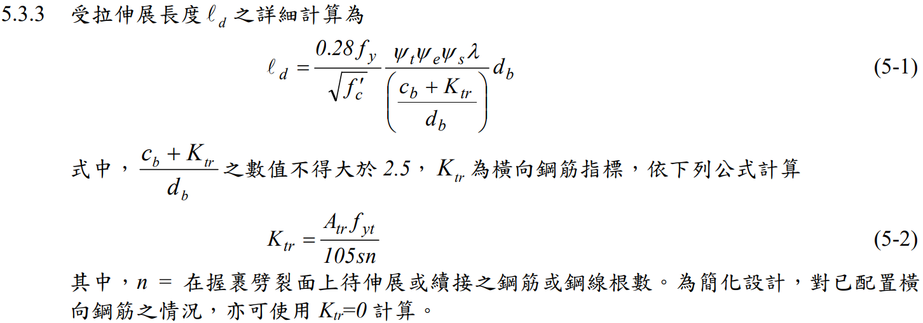
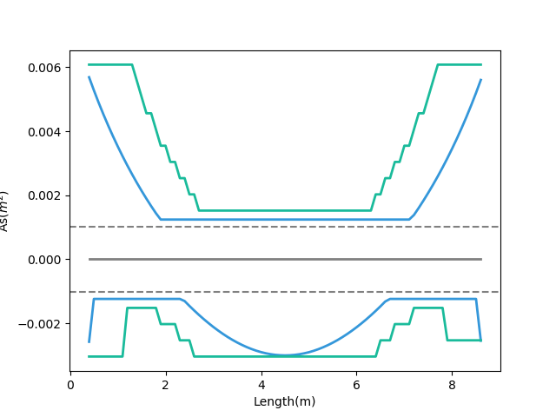
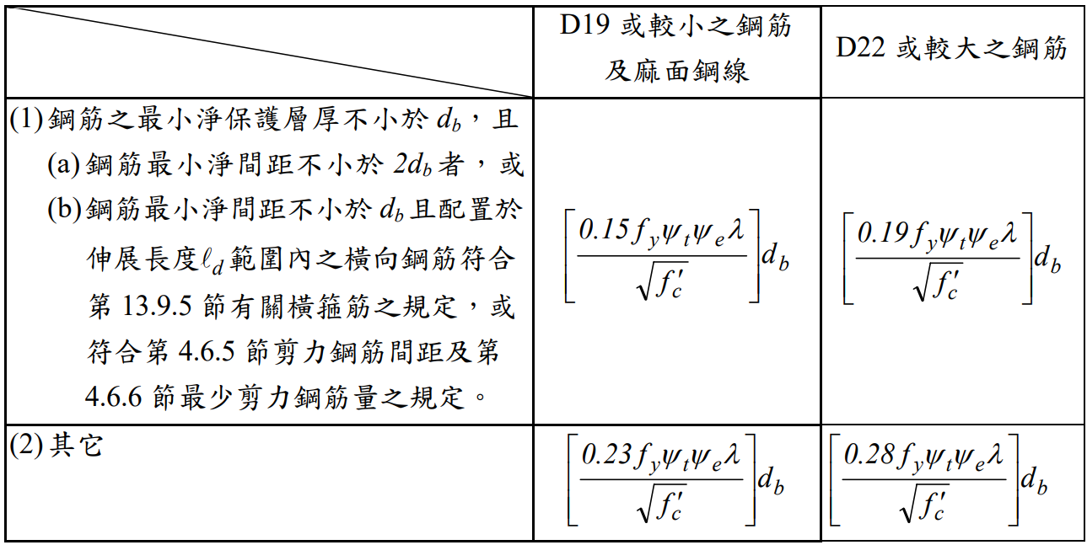
General Development Length Equation
- Demand As
- After Consider Ld As
Top Rebar
MIN
Simplified Provisions
Bottom Rebar
Ld
Notes:
LowSeismic 4Floor 12M 0

Slide 11
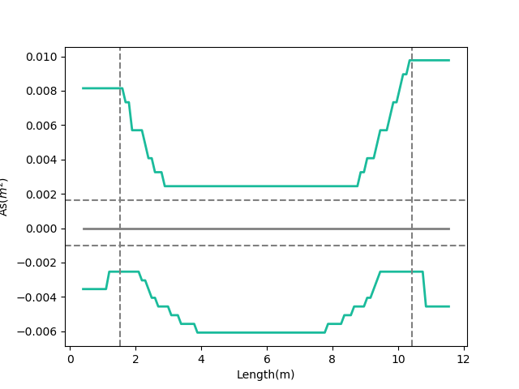
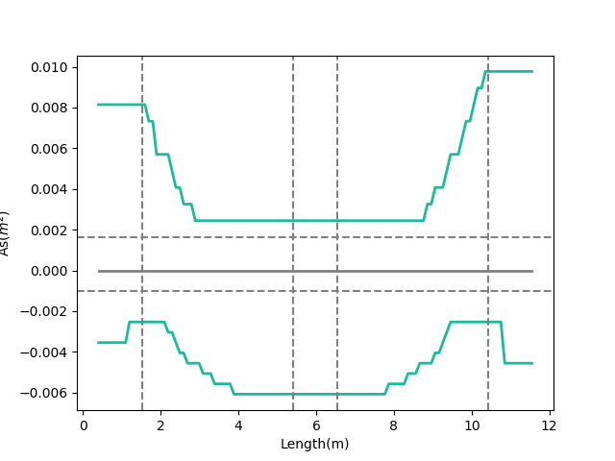
Combinations
Multi-Cut
Multi-Cut-2
- Consider Ld As
- Consider Ld As
0.1
Ln
0.9
Ln
Notes:
GA 演算法
LowSeismic 4Floor 12M 0

Slide 12
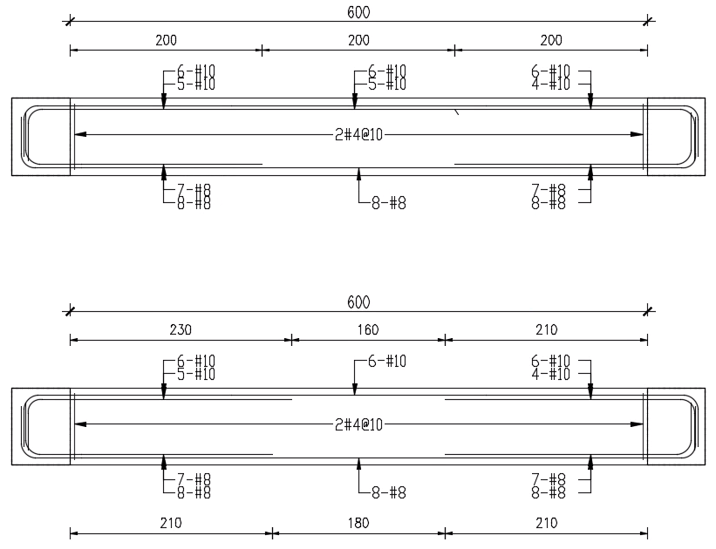
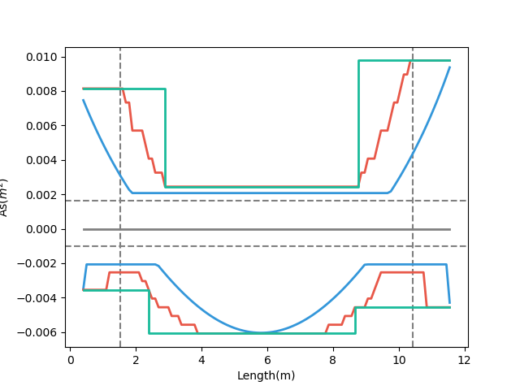
- Demand As
梁撓曲鋼筋配置示意圖
- Consider Ld As
- Design As
Multi-Cut-2
Notes:
LowSeismic 4Floor 12M 0

Slide 13
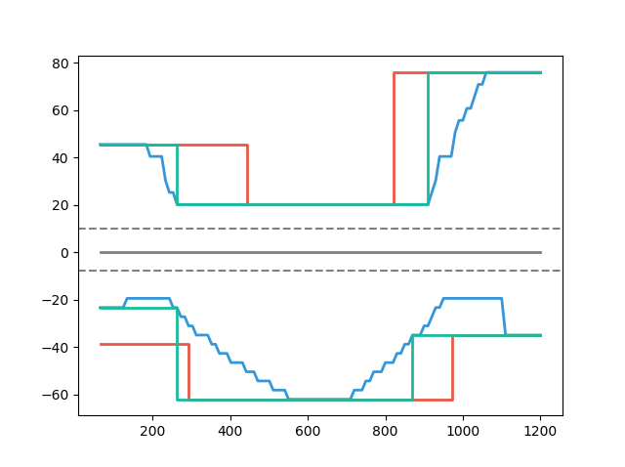
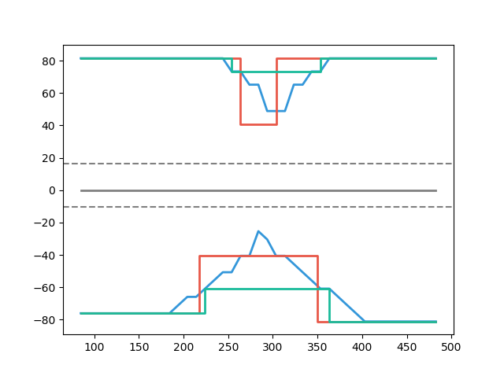
Multi-Cut-2 vs Tradition
- Multi-Cut-2
- Consider Ld
- Consider Ld
- Tradition
- Tradition
Multi-Cut-2 82%
Top Rebar
As(cm2)
As(cm2)
Multi-Cut-2 91%
Bottom Rebar
Length(cm)
Length(cm)
Notes:
傳統不經濟
828
傳統不保守 不符合 混凝土結構設計規範 401-100 R5.11.2
1140

Slide 14
Outline
Part 2
Part 4
Flexural Reinforcement Multi-Cut
Seismic Verification
Part 1
Part 3
Objective
Condition

Slide 15
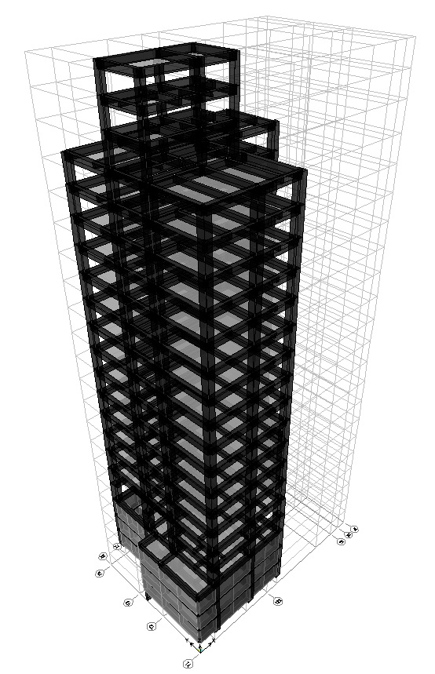
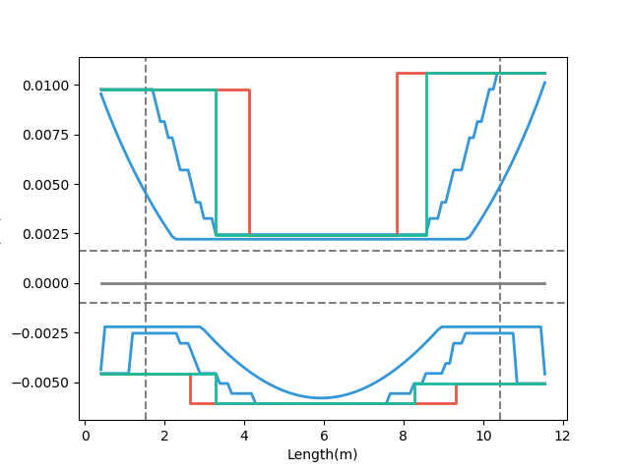
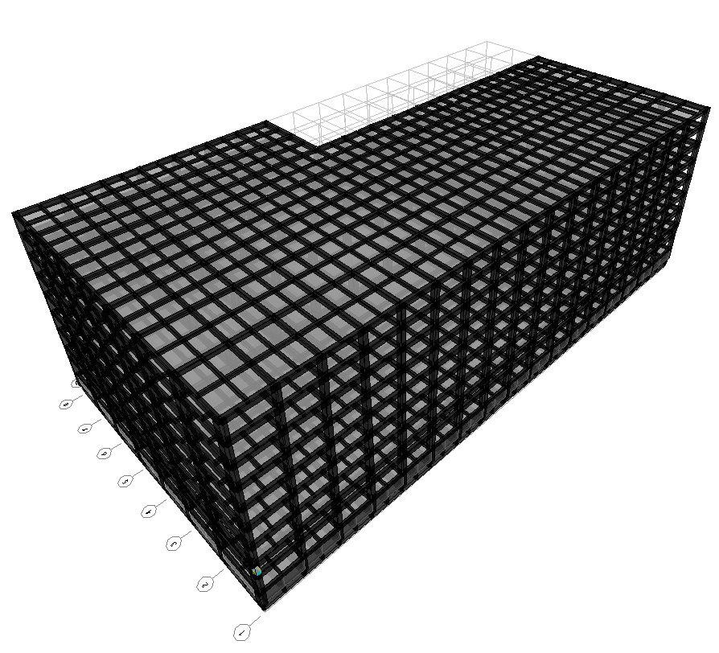
- Demand
- Tradition
- Multi-Cut-2
台北住宅案
高雄物流中心
Notes:
LowSeismic4Floor12M 0

Slide 16
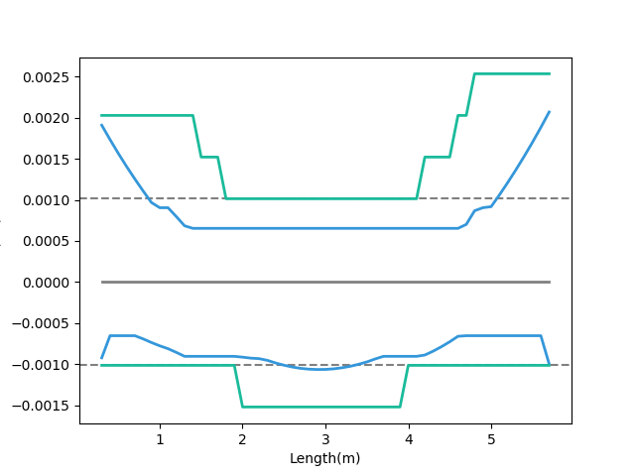
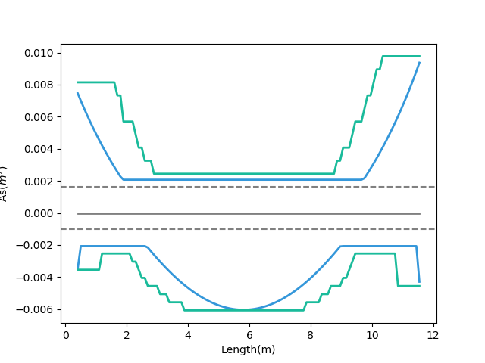
- Demand As
- Consider Ld As
Ld
Short Development Length
Beam Length
Notes:
LowSeismic4Floor12M 0

Slide 17
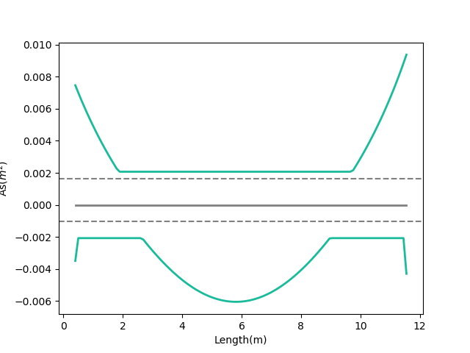
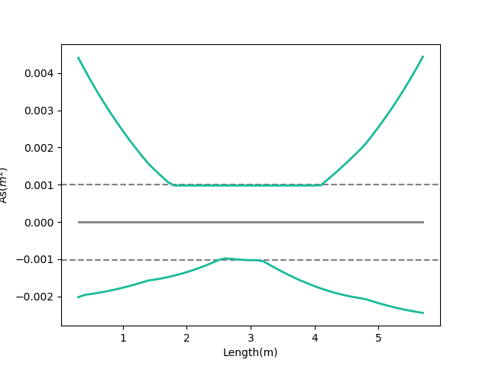
Moment Decay
- Moment Demand As
- Moment Demand As
Large Slope
Small Slope
Notes:
LowSeismic4Floor12M 0

Slide 18
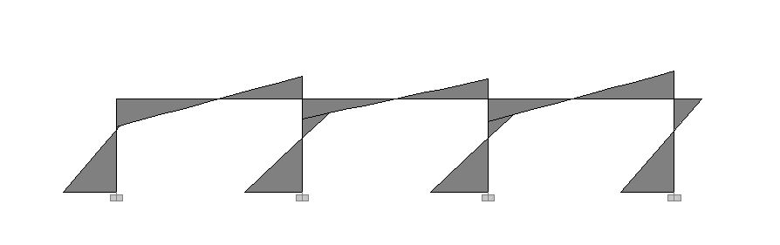
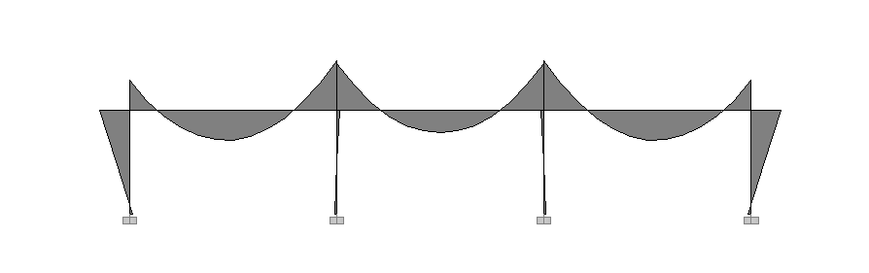
Lateral Load
Lateral
Force
Moment Diagram
Gravity Load
Gravity Load

Slide 19
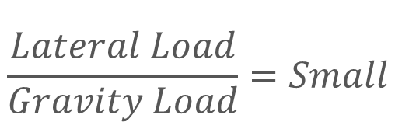
Lateral
Force
Moment Decay
$$\frac{Lateral Load}{Gravity Load}=Small$$
Gravity Load
Beam Length

Slide 20
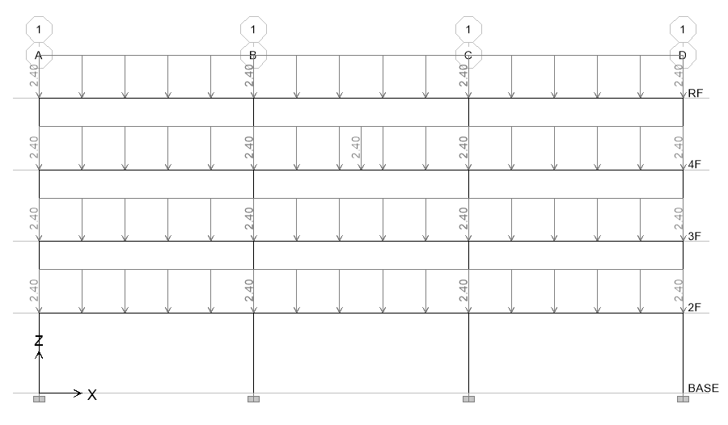
11 Models
4m
4.5m
Notes:
LowSeismic4Floor12M 0

Slide 21
整體優化結果
Beam Length
6m
9m
12m
High Seismic
100.6%
94.2%
94.8%
Site
Middle Seismic
99.6%
95.3%
93.6%
Low Seismic
98.1%
94.5%
90.4%

Slide 22
整體優化結果
Beam Length
6m
9m
12m
High Seismic
100.6%
94.2%
94.8%
Site
Middle Seismic
99.6%
95.3%
93.6%
Low Seismic
98.1%
94.5%
90.4%

Slide 23
上層筋優化結果
Beam Length
6m
9m
12m
High Seismic
103.4%
97.4%
94.9%
Site
Middle Seismic
104.4%
96.0%
91.2%
Low Seismic
99.5%
91.2%
86.0%

Slide 24
下層筋優化結果
Beam Length
6m
9m
12m
High Seismic
96.1%
89.0%
94.6%
Site
Middle Seismic
91.9%
94.3%
97.2%
Low Seismic
96.0%
99.4%
96.5%

Slide 25
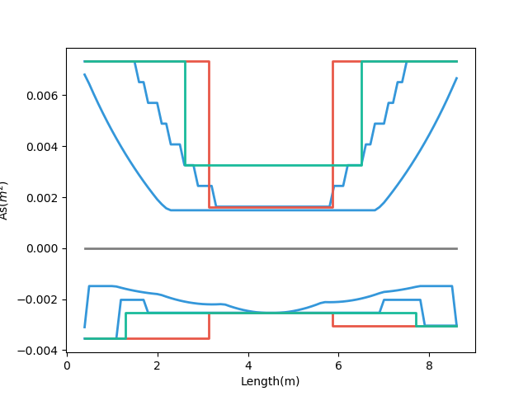
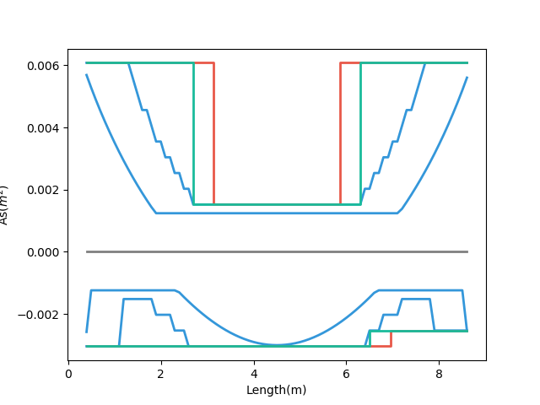
Why?
- Demand
- Tradition
- Multi-Cut-2
- Demand
- Tradition
- Multi-Cut-2
Small Gravity 89%
Bottom Rebar
Large Gravity 99%
5-#8
6-#8
5-#8
7-#8
6-#8
6-#8
High Seismic
Low Seismic
Notes:
HighSeismic 4Floor 9M 12
LowSeismic 4Floor 9M 12

Slide 26
More Multi-Cut
2
3
4
5
Unlimited
Notes:
理論最佳解

Slide 27
台北住宅案
100.0%
OVERALL RESULT
14F B3
101.3%
TOP RESULT
98.5%
BOT RESULT
20m
30m
Notes:
由於很複雜，先記得最終的結果
400

Slide 28
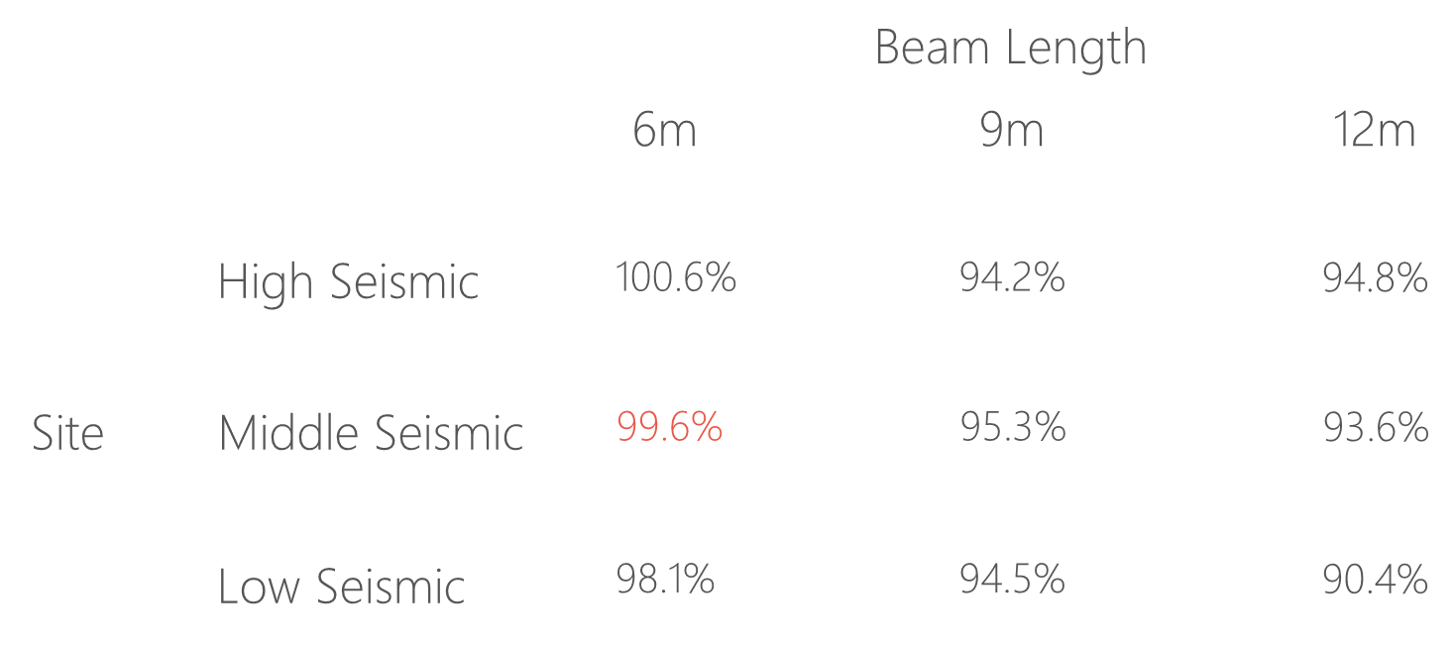
台北住宅案

Slide 29
9F B1
93.4%
OVERALL RESULT
92.3%
TOP RESULT
153m
77m
94.7%
BOT RESULT
高雄物流中心
Notes:
3500

Slide 30
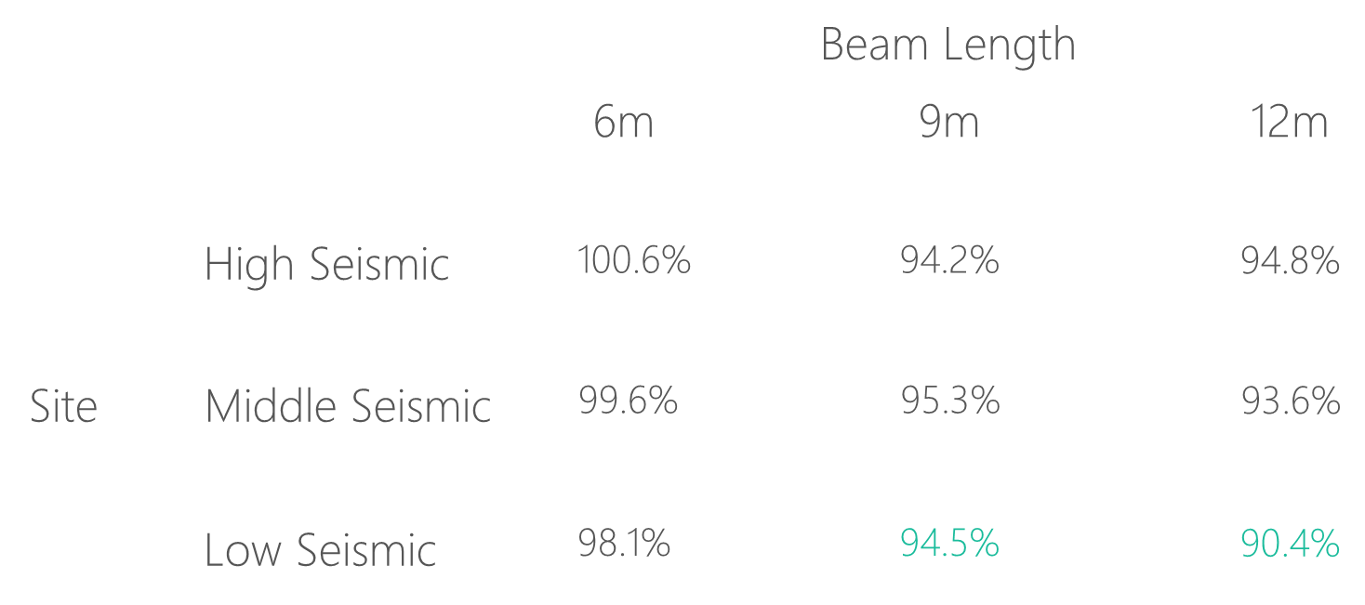
高雄物流中心

Slide 31
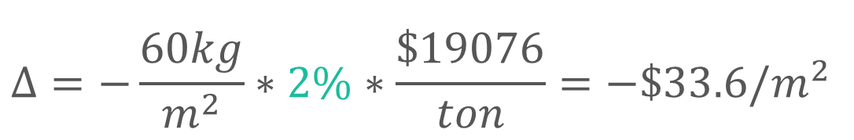
Cost Analysis
Reduced Percentage
Material Reduced Cost
$$Δ=−\frac{60kg}{m^{2}}∗2\%∗\frac{\$19076}{ton}=−\$33.6/m^{2}$$
Girder Used
Material Cost
資料來源: 公共工程價格資料庫

Slide 32
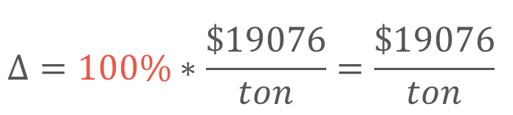
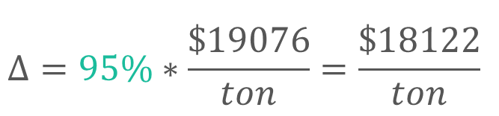
Material Cost
Tradition
Multi-Cut
$$Δ=100\%∗\frac{\$19076}{ton}=\frac{\$19076}{ton}$$
$$Δ=95\%∗\frac{\$19076}{ton}=\frac{\$18122}{ton}$$
Material Cost
Reduced Percentage
資料來源: 公共工程價格資料庫 2019

Slide 33
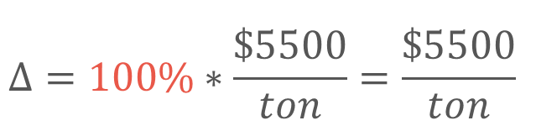
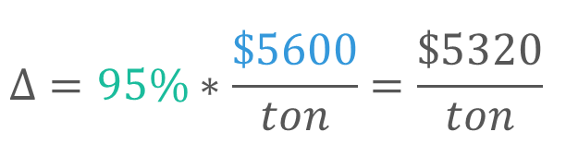
Construction Cost
Tradition
Multi-Cut
$$Δ=100\%∗\frac{\$5500}{ton}=\frac{\$5500}{ton}$$
$$Δ=95\%∗\frac{\$5600}{ton}=\frac{\$5320}{ton}$$
鋼筋綁紮工資
複雜度增加 => 鋼筋綁紮工資增加
資料來源: 台北市公共工程實際採用單價 2019

Slide 34

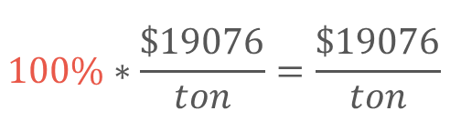
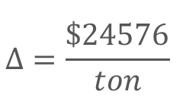
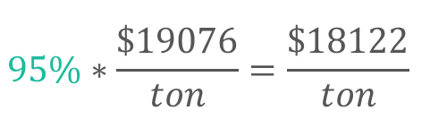
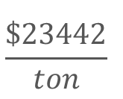
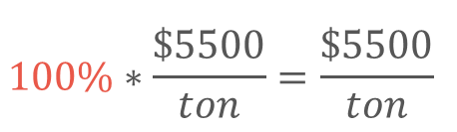
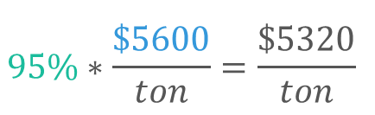
Cost Analysis
$$95.4\%$$
Tradition
Multi-Cut
$$100\%∗\frac{\$19076}{ton}=\frac{\$19076}{ton}$$
$$95\%∗\frac{\$19076}{ton}=\frac{\$18122}{ton}$$
Material Cost
Construction Cost
$$100\%∗\frac{\$5500}{ton}=\frac{\$5500}{ton}$$
$$95\%∗\frac{\$5600}{ton}=\frac{\$5320}{ton}$$
Total Cost
$$Δ=\frac{\$24576}{ton}$$
$$\frac{\$23442}{ton}$$

Slide 35

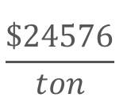
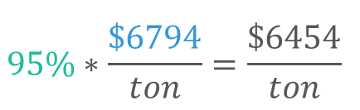
Cost Analysis
$$100.0\%$$
Tradition
Multi-Cut
$$100\%∗\frac{\$19076}{ton}=\frac{\$19076}{ton}$$
$$95\%∗\frac{\$19076}{ton}=\frac{\$18122}{ton}$$
Material Cost
Construction Cost
$$100\%∗\frac{\$5500}{ton}=\frac{\$5500}{ton}$$
$$95\%∗\frac{\$6794}{ton}=\frac{\$6454}{ton}$$
Total Cost
$$Δ=\frac{\$24576}{ton}$$
$$\frac{\$24576}{ton}$$

Slide 36
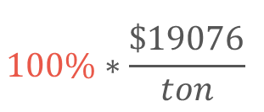

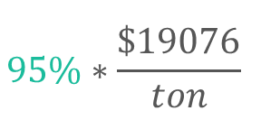

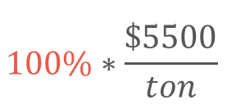
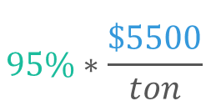
Cost Analysis
Multi-Cut-2
Tradition
Multi-Cut-2
$$100\%∗\frac{\$19076}{ton}$$
$$95\%∗\frac{\$19076}{ton}$$
Material Cost
Construction Cost
$$100\%∗\frac{\$5500}{ton}$$
$$95\%∗\frac{\$5500}{ton}$$
Total Cost
$$100\%$$
$$95\%$$

Slide 37
Outline
Part 2
Part 4
Flexural Reinforcement Multi-Cut
Seismic Verification
Part 1
Part 3
Objective
Condition

Slide 38
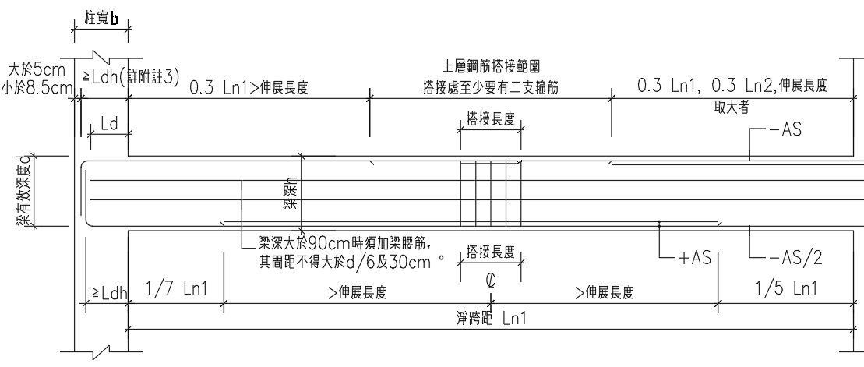

12-#10
Consider Ld
12-#10
10-#10
10-#10
3-#10
3-#10
7-#8
7-#8
9-#8
9-#8
12-#8
12-#8

Slide 39

Hinges Only On Ends vs Multi-Hinges
Incremental Dynamic Analysis

Slide 40


Pushover Load Pattern
Inverted Triangle
Multi-Modes Combination
Modal Pushover Analysis
Mode Shape
Effective Mass
SRSS
Notes:
定義非線性驗證的邊界

Slide 41
Inverted Triangle
Low Seismic 12m 90.4%
Tradition
Multi-Cut-2

Slide 42




Step 2
Step 3
Step 5
Step 7

Slide 43
Gravity Load
Forth Hinge
Gravity Load
+
Lateral Load

Slide 44



Without Gravity Load
First Hinge

Slide 45

Time History Analysis
Story Drift
Scaled to DBE, MCE
- Time History Spectrum
- DBE Spectrum
- MCE Spectrum
DBE < 1.5%
MCE < 2%

Slide 46


DBE < 1.5%
Low Seismic 12m 90.4%
Tradition
Multi-Cut

Slide 47


MCE < 2.0%
Low Seismic 12m 90.4%
Tradition
Multi-Cut

Slide 48




Tradition DBE
Multi-Cut DBE
Tradition MCE
Multi-Cut MCE
Notes:
DBE 1602 11.5
MCE 1116 15.5

Slide 49


Incremental Dynamic Analysis
Single Static Analysis
➔
Incremental SPO
Single Time History Analysis
➔
Incremental One

Slide 50


Limit-State
4% FEMA273
2.5% SEAOC2000

Slide 51


IDA
Low Seismic 12m 90.4%

Slide 52
Conclusion
Condition
Verification
Long Span
Low Seismic
Capacity Close To Tradition
Objective
Construction
Reduce Rebar
Today or Future Cost

